Slide 1

Improving the QoE of Internet-based Mobile Applications
Mallesham Dasari
Stony Brook University
Notes:
Good afternoon everyone! So I have been working on issues related to quality of experience of mobile Internet applications. In today’s talk, I will summarize the contributions of my work so far.

Slide 2
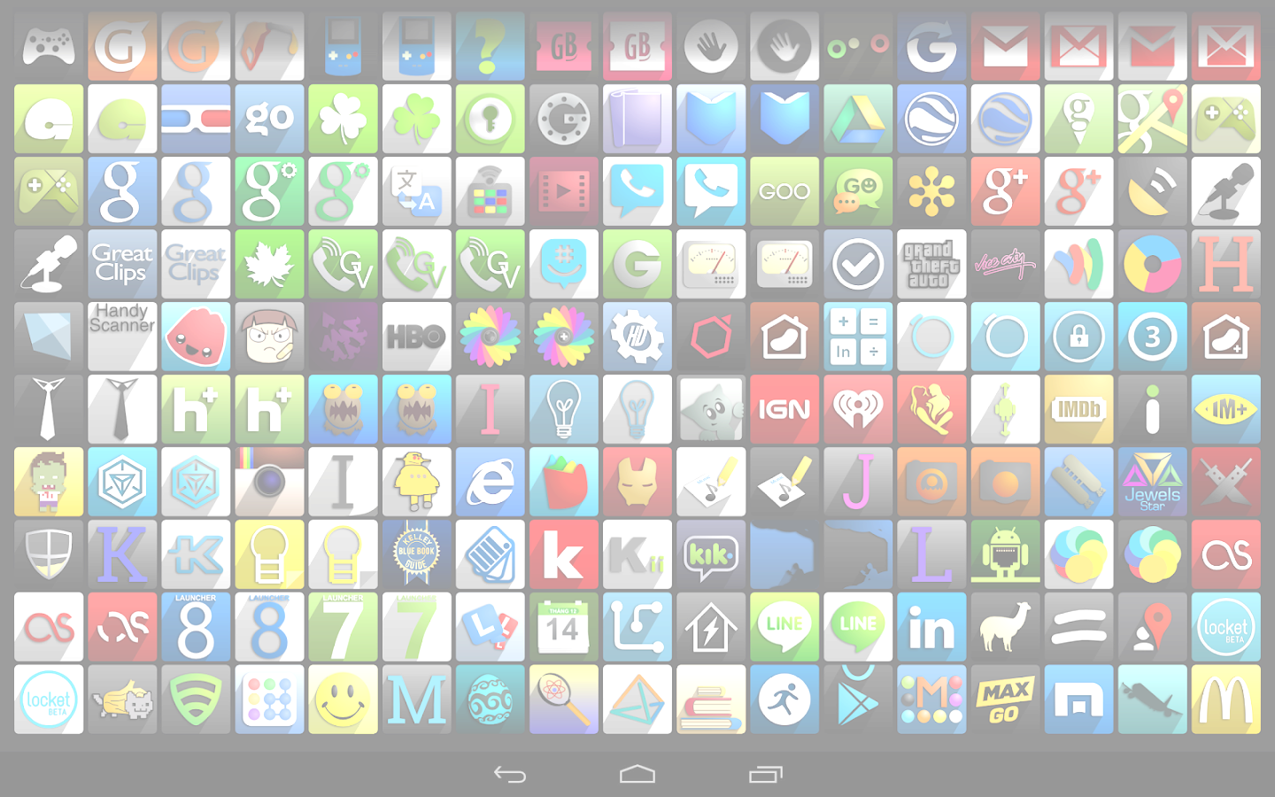

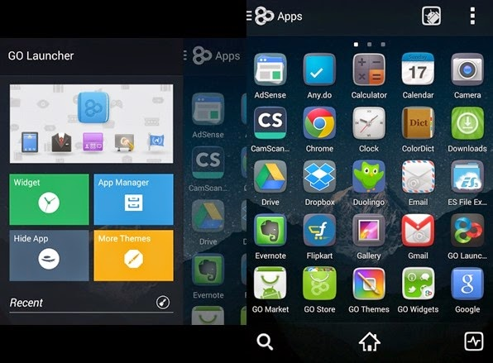
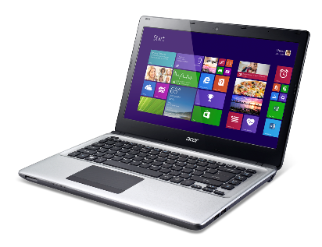

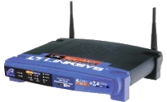
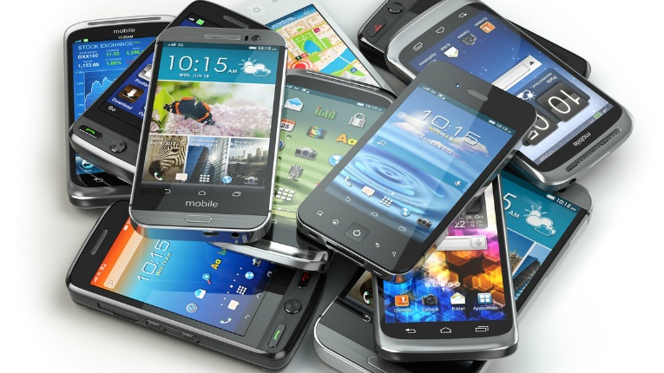
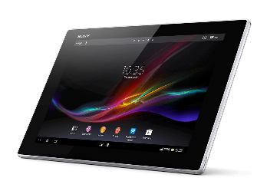


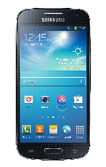

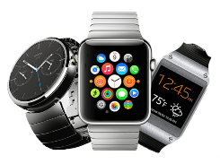
Mobile Internet Ecosystem
Diverse Apps
Diverse Devices
Diverse Networks
Understanding QoE issues – Hard!
Notes:
So what exactly mean by mobile Internet. It is large ecosystem consisting of diverse Internet based applications, diverse mobile devices, and diverse networks. Because of this mixed technologies, it has become harder to identify the root cause of QoE issues and thereby improvement. In this work, I will try to understand the network- and device-side bottlenecks and try to improve the QoE of these applications.

Slide 3





Overview
QoE
QoE
Network
Bottlenecks
Device
Bottlenecks
ACM/IEEE IWQoS’18
In Submission (IMC’18)
Understand and Improve QoE
Notes:
To give you a brief idea of the overall talk, I will first discuss QoE improvement by understanding the network-side bottlenecks and efficient network resource provisioning. This work was in collaboration with HP labs and was accepted to IWQoS. In the second part of the talk, I will focus on QoE improvement by understanding device-side bottlenecks for these applications.

Slide 4






Network Resource Provisioning
Internet
QoE
QoS
Training Mobile Device
QoE Model
IQX Hypothesis (Fielder et. al, IEEE TON Mar’2010)
Notes:
So currently, the last hop routers for example Aruba WiFi has no idea how the users experience is. All that it knows is the QoS parameters such as network throughput, loss and latency. Traditionally, the network administrators used to estimate these parameters based on packet statistics and control the network resources. But, recently it has been proven that QoE based network resource provisioning performs better than QoS. However, knowing the QoE from end-users is not feasible in real time, so some prior work mapped QoE based on QoS.

Slide 5


Network Resource Provisioning
Internet
QoE
QoS
Training Mobile Device
QoE Model
IQX Hypothesis (Fielder et. al, IEEE TON Mar’2010)
Notes:
We can train this experience under diverse network conditions using a machine learning model and use this data-driven QoE model in resource provisioning. And there are many application categories such as browsing, streaming and telephony. It is highly unlikely to have a generic model for all these application categories. So anyway, Aruba which is acquired by HP wanted to make their WiFi AP intelligent by embedding the QoE of end-users and as an initial attempt we focus on modeling telephony applications. And there we face few challenges. This model here requires the ground-truth QoE information to map with QoS. But currently,

Slide 6



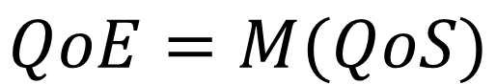
Problem
Lack of QoE information for
several applications
Application | QoE Information
Skype | (some versions)
Hangouts/Duo
Facetime
Skype Technical Info
Notes:
Most of these applications does not provide any such QoE information. For example, Skype provides some sort of technical information during the call, which previously people used to model QoE but is not available on all versions especially recent versions. And, as you know, the training phase is very important for machine learning, which requires the ground-truth data.

Slide 7
Problem
Lack of QoE information for
several applications
Application | QoE Information
Skype | (some versions)
Hangouts/Duo
Facetime
Skype Technical Info
Can we assess the QoE
without any support from the application?
Notes:
So, how can we get this ground-truth data without any support from the application? This is especially important with massive increase in number of video applications.

Slide 8
How to get QoE Ground-Truth?
User-study, MOS
Amazon Mechanical Turk
Subjective
Metrics
Bitrate, Fps,
Resolution
Objective
Metrics
Limited by content
and
application
Notes:
So, we can go for either subjective or objective metrics. Subjective metrics mean, you go to user and ask his rating on the experience. Do it for many users and take the mean opinion score. Which is obviously not a cost-effective solution. So, instead obtaining QoE information from video programmatically. For example, we can extract bitrate, frames per second and resolution of video.

Slide 9
How to get QoE Ground-truth?
User-study, MOS
Amazon Mechanical Turk
Subjective
Metrics
Bitrate, Fps,
Resolution
Objective
Metrics
Limited by content
and
application
Need for a scalable, content- and application-agnostic QoE metrics
Notes:
But these are not available for many applications and whatever available are content specific. So we see there is a need for more robust design of QoE metrics.

Slide 10
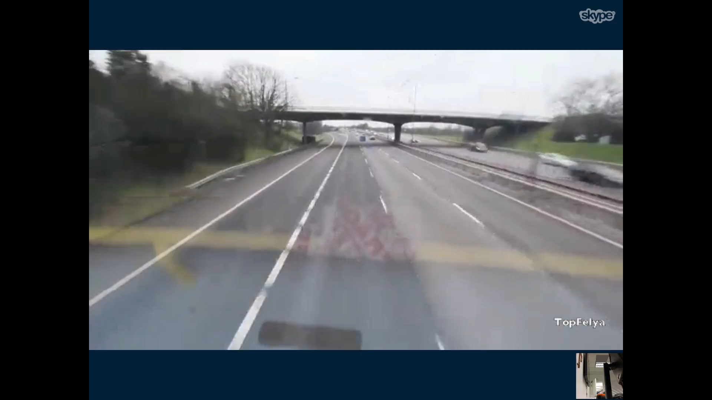
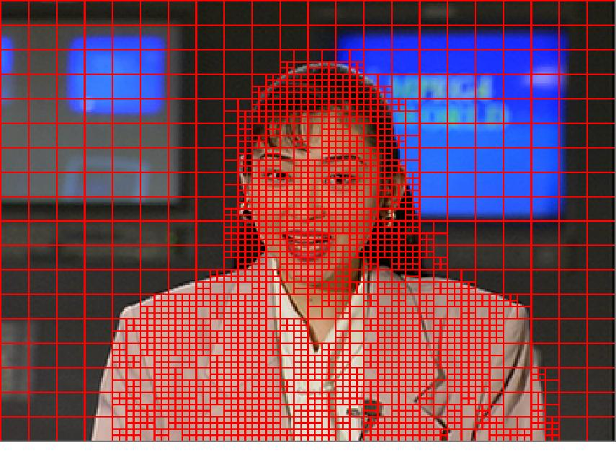

Video Coding Primer
Frame Prediction
Intra- and Inter-frame prediction
Transform Coding and Quantization
Most of the “energy” is compacted into a few coefficients.
Use quantization for lossy coding
Entropy Coding
Intra Frame Prediction
Inter Frame Prediction
Notes:
So before introducing our metrics, let me brief you with video coding concepts which helps understanding our metrics. Typically video coding is performed in three stages: Frame Prediction, Transform coding and Quantization, Entropy coding. So you can think of video as a sequence of frames. These video frames has lot of redundancy so we can reduce the size of video by compression. The encoder first divides the frames into multiple blocks (for example here) and try to predict each block from previously coded blocks. If block matching is performed within the frame, then it is called intra prediction. If block matching is performed across frames, then it is called inter frame prediction. That means, these two methods capture spatial i.e. within image and temporal i.e. across frames redundancy. Then, the predicted residuals are sent to next stage of coding process i.e. transform and entropy coding. Although we exploit all these stages, further details are not required to understand our approach. Now that we have seen some background, let us get back to our initial concern on QoE artefacts.

Slide 11
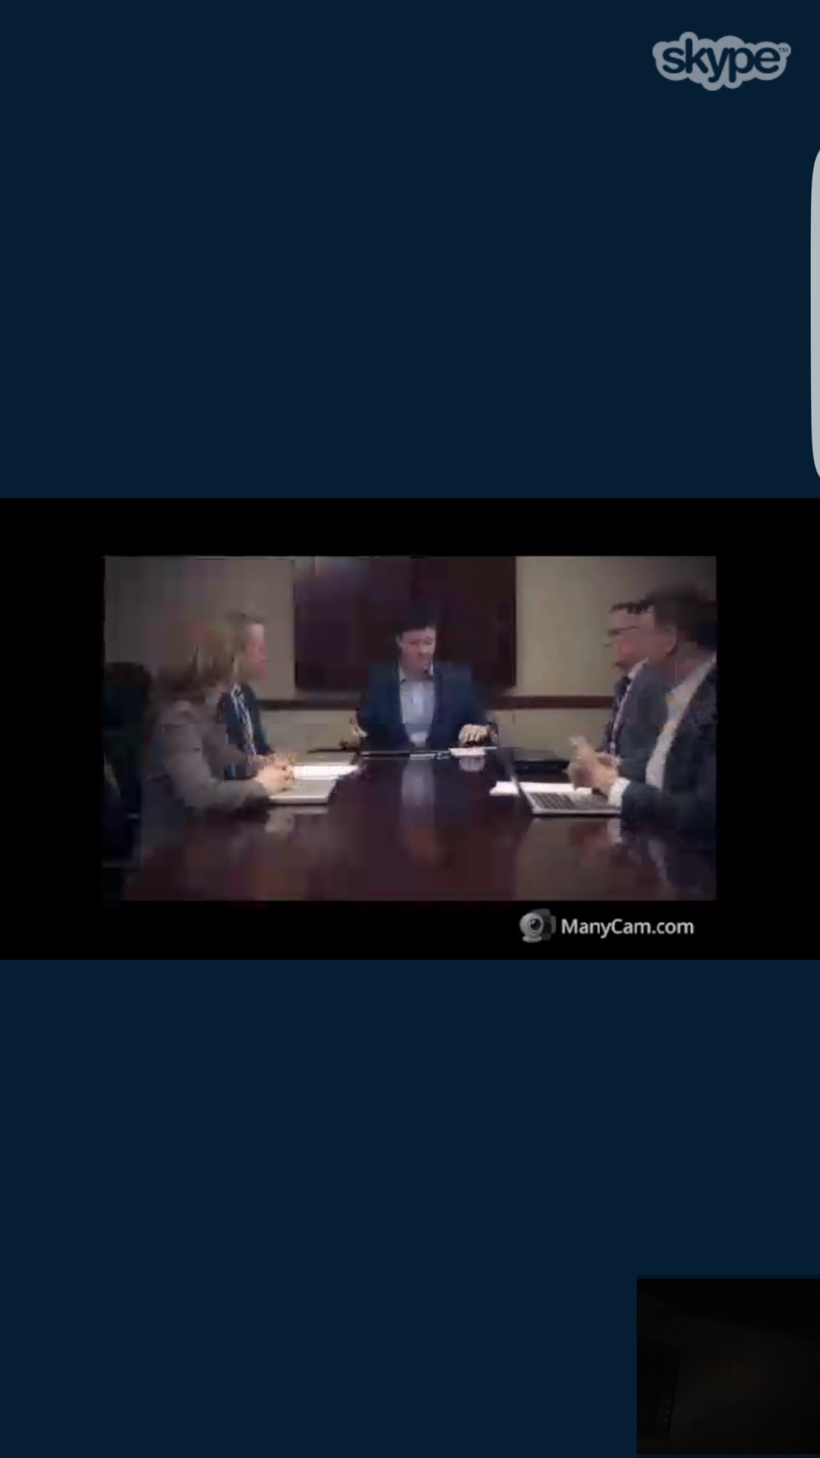
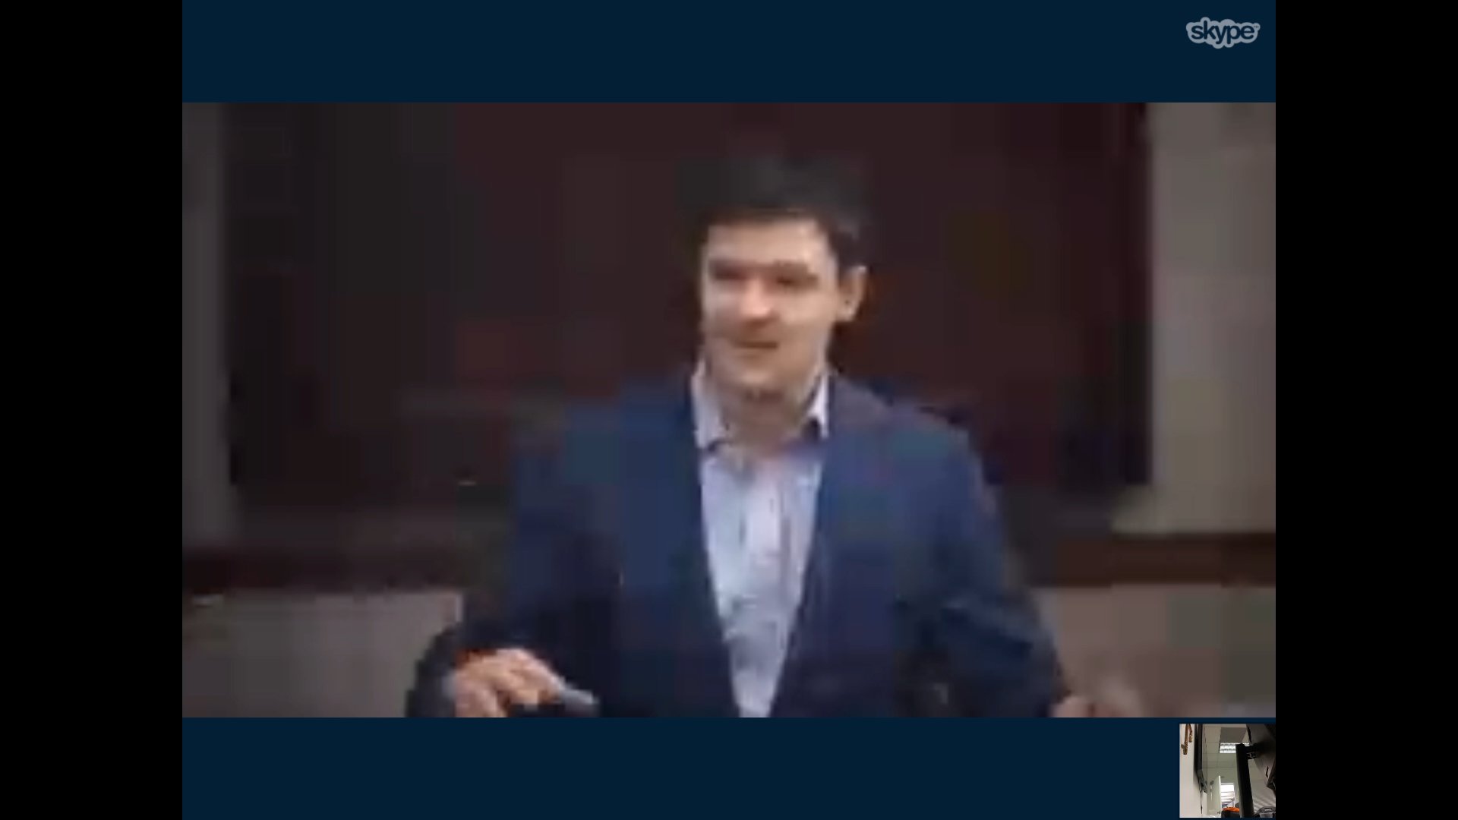
Video QoE Artifacts
Blurring effect (Spatial)
Freezes (Temporal)
QoE = f(Blur, Freezes)
We want to capture these artifacts
Notes:
So what exactly do we need to consider to while designing metrics. Here is a blurred image that screenshot under bad network conditions. Obviously, when we see the blurred image, our experience is not satisfactory. Similarly, you get bad experience when you see video freezes like this. So the aim is to capture these artefacts. Remember our goal: getting the ground-truth data for training the machine learning model? This is it.

Slide 12
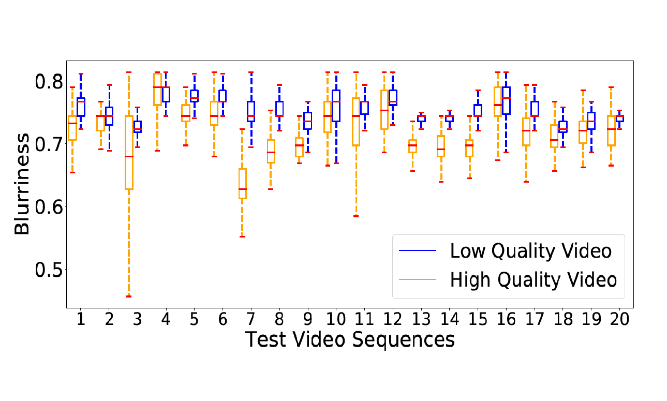
Limitations of prior QoE Metrics
No clear separation between low quality and high quality videos
Even for same video too much overlap
Similar behavior for temporal variation
1. X. Marichal, Wei-Ying Ma and HongJiang Zhang, "Blur determination in the compressed domain using DCT information," Springr 2016
Notes:
There is some recent work in vision community for blur detection but most of them are for images. We used some recent models to detect blur across 20 different low quality and high quality videos. Here, y-axis is the amount of blurriness ranging from 0 to 1. As you see, the box plot shows no proper separation between the blurriness of low and high quality videos. Also, even for a same video, the blurriness variance is too high. That means we cannot really rely on this metric. Apart from this metric, we also experimented with six other well known blur detection algorithms where none of them have shown good measure. A similar trend was seen with freeze related metrics too.

Slide 13
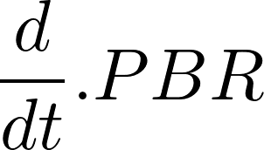
Our QoE Metrics (Spatial)
1. Perceived Bitrate (PBR)
Typically video compression is very motion sensitive
Use intra only
Matching macroblock is chosen from the same image.
2. cPBR( )
Recorded video bitrate – Compressed video bitrate
Recorded video bitrate
PBR = x 100
Notes:
Now, let us go into the details of our metrics. We consider several metrics to capture both spatial and temporal artifacts videos. So for all the applications, we screen record the video during the call and process the videos later to get the objective QoE metrics. Our first metric is perceived bitrate which is a modified version of video bitrate. Typically, the bitrate is high for high motion videos and low for low motion videos. This difference stems from the inter-frame prediction stage of video compression which we avoid to make it motion independent metric as our goal is not compression. To make it content agnostic, we take the percentage change in the recorded video bitrate and compressed video bitrate. We also take the gradient of this PBR metric as another metric to capture the influence of number of times the quality of video changes. Next,

Slide 14
Our QoE Metrics (Temporal)
3. Freeze Ratio
Ffmpeg’s mpdecimate
Similar to Inter-frame prediction
4. Number of freezes
5. Length of freezes
Number of unique frames
Total frames
Freeze Ratio = 1 -
Notes:
Our temporal metrics are about the freezes. We calculate freeze ratio using Ffmpeg’s mpdecimate filter, which works similar to inter frame prediction. Remember the inter frame prediction? It computes the difference between current and previous frame to remove the redundancy. So, here if all the blocks of two frames are same, then the frame is considered to be duplicate. That way, we get total unique frames over a given window. So we define stutter ratio as 1 minus unique frames over total frames. So we introduced two metrics to get the QoE ground-truth data. Now, we want to see the performance of these metrics through empirical study. For that,

Slide 15
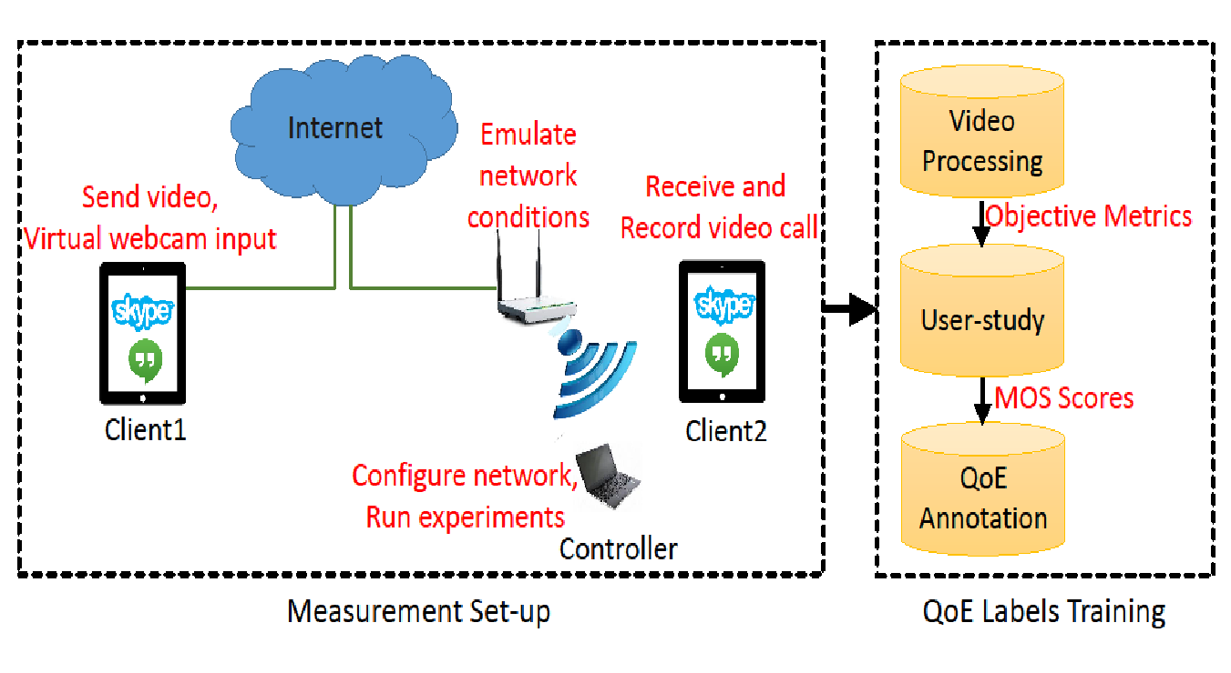
Measurement Testbed
Notes:
We have this measurement setup. We have two clients, one in our LAN and other is in Amazon cloud. The amazon instance has a virtual webcam that gives a pre-recorded video as input to Skype or Hangouts applications. There is also a controller which is running experiments on mobile devices connected through ADB interface through USB or WiFi. The AP will emulate diverse network conditions to get different quality of videos. Finally, we map our QoE metrics to actual user’s experience scores using ML models which I will describe later.

Slide 16
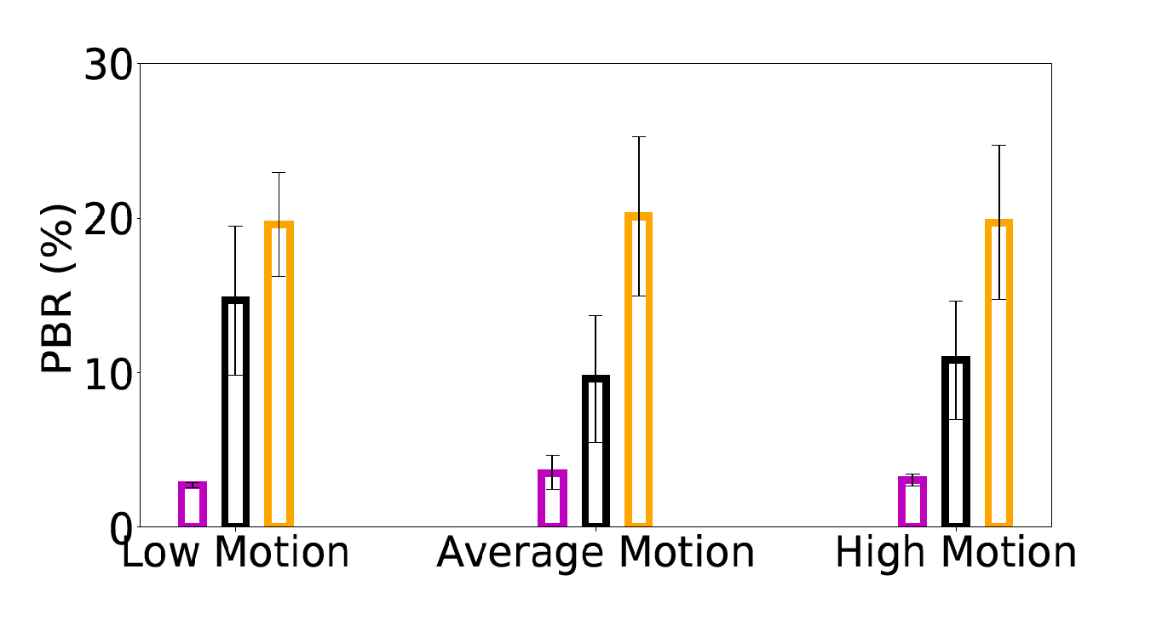
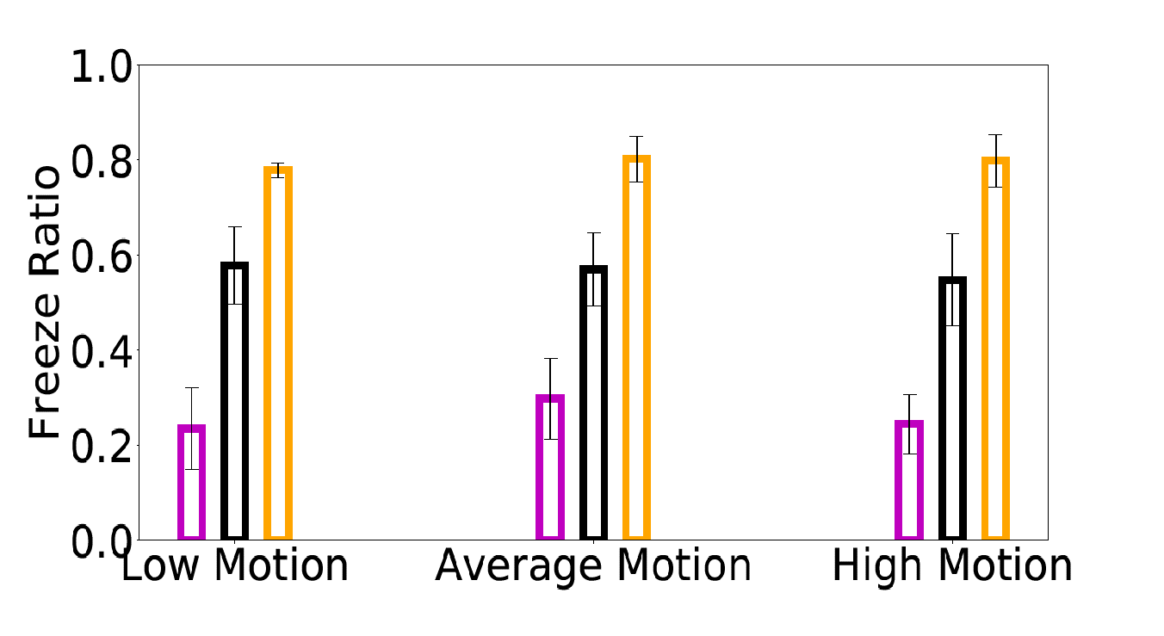
Microbenchmark of QoE Artifacts
Content and Motion Diversity
Clear separation between good, average and bad
Network conditions
Notes:
So, we benchmark the QoE artefacts with respect to different content, motion, applications, and devices. This plot here shows the PBR and freeze ratio for diverse contents and motion under three different network conditions. As needed, the metrics have clear boundary for different network conditions. That is, we can easily distinguish between good, average and bad quality videos. Next,

Slide 17
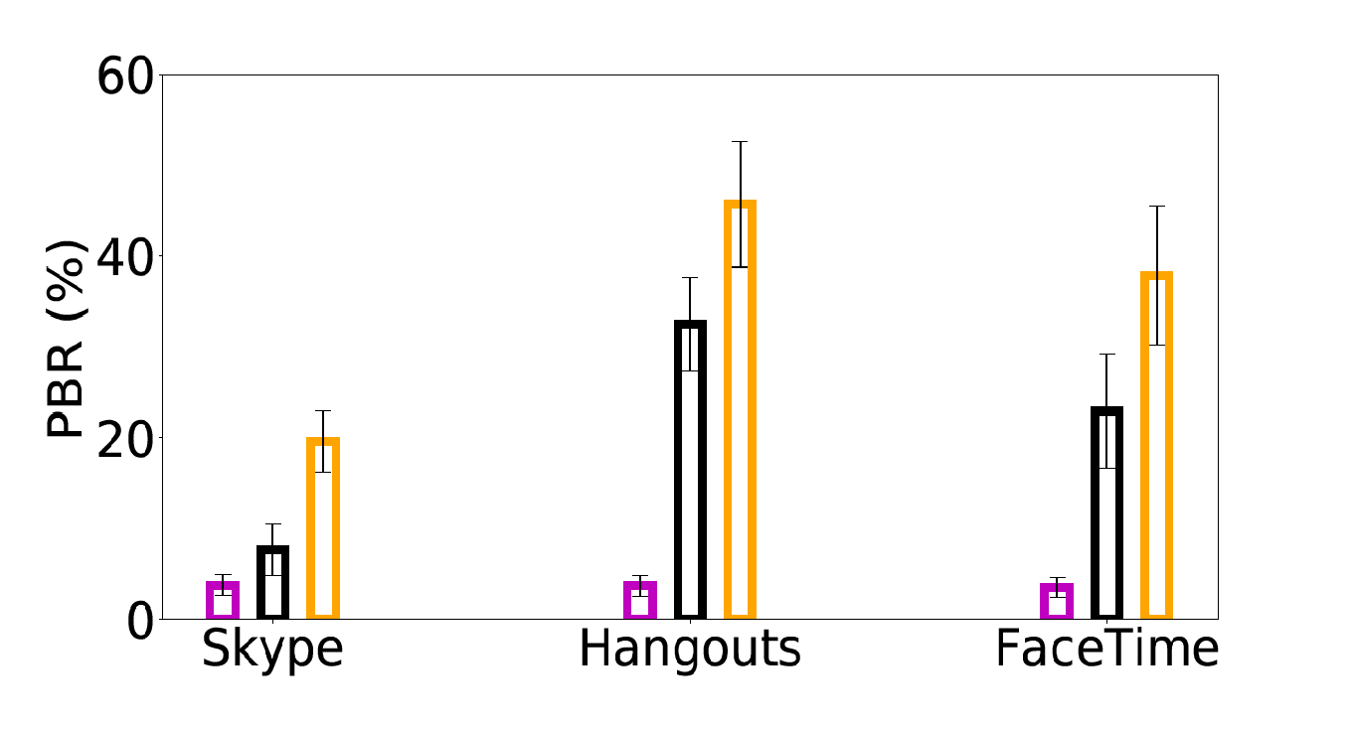
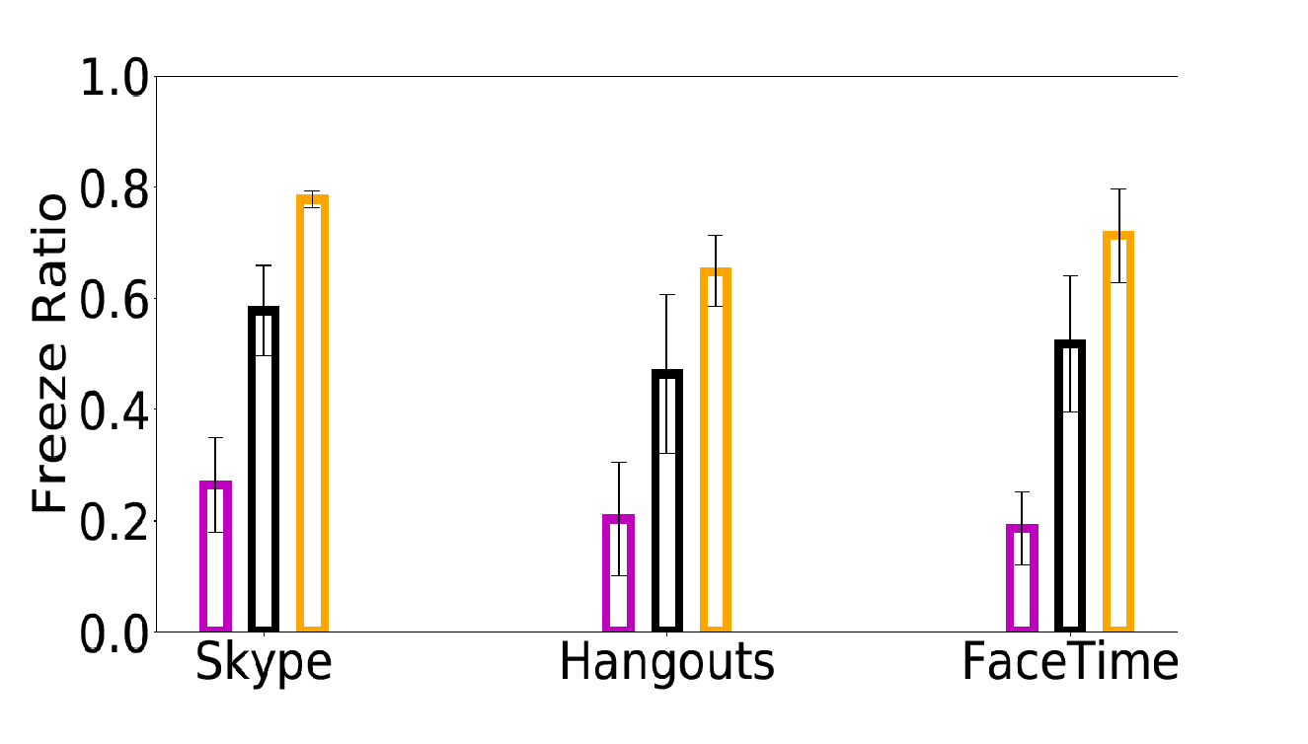
Microbenchmark of QoE Artifacts
Application Diversity
Higher bitrate change for Hangouts
More blurry video in case of Hangouts compared to Skype
Notes:
This plot shows the metrics performance among applications. As you, PBR and freeze ratio trend is similar to previous but different among applications. That is, Skype has very low PBR even under band network. This is because Skype does not compromise the quality of the image over freezes unlike other applications. This shows that, we need a model per application.

Slide 18
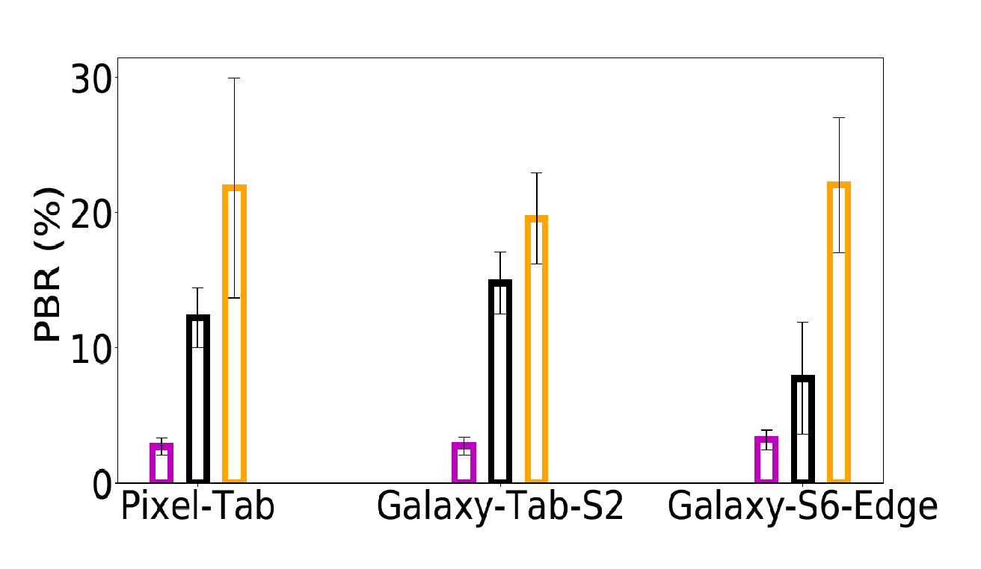
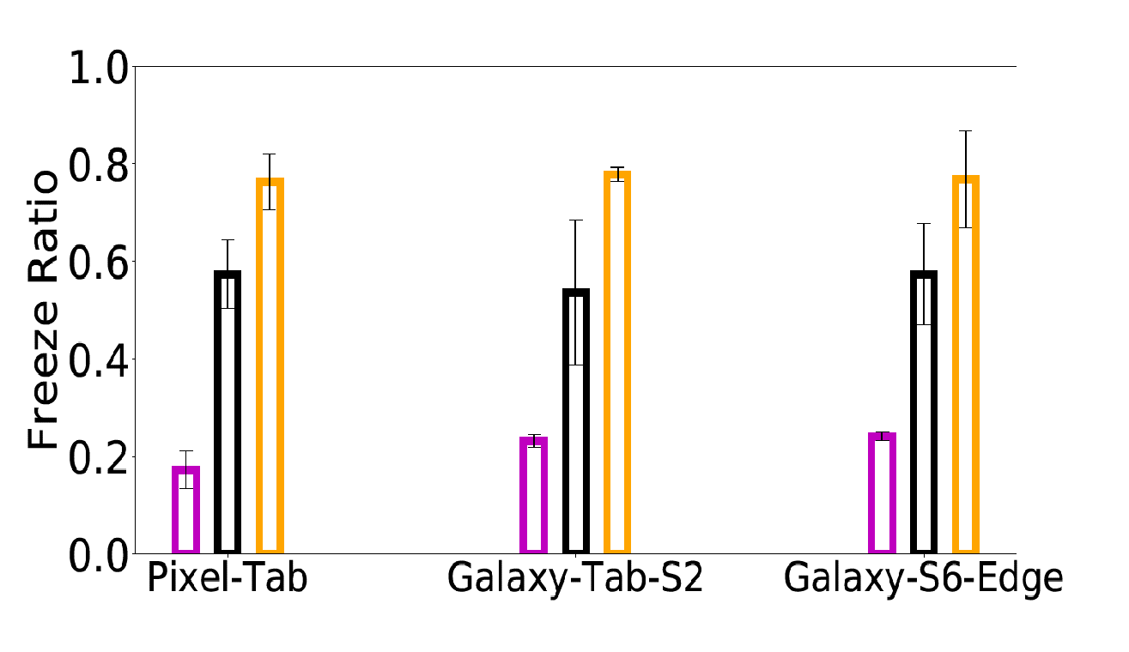
Microbenchmark of QoE Artifacts
Device Diversity
Similar trend with other measurements, no impact of device as the recording resolution is same
Notes:
Finally, the metrics should not sensitive to devices. We measure this by using three different devices. As required, the trend is similar and does not change because of device as the underlying recorder and recording resolution is same. This shows that out metrics are scalable across diverse contents, motion, applications and devices.

Slide 19
MOS Prediction Model
User-study
MOS
Predict MOS
From QoE Metrics
QoE = M (Blur, Freezes)
Validate the QoE metrics by mapping them to actual
users’ experience
800 video samples from 20 diverse videos, 200 users
Notes:
We have several QoE metrics here. We validate these metrics by modeling with actual users experience. To this end, we conduct a user study to see the correlations between user perception and our metrics and to validate them. We conduct a user-study with both lab and online users on Amazon mechanical turk with a total of 200 users and 800 video clips. And,

Slide 20
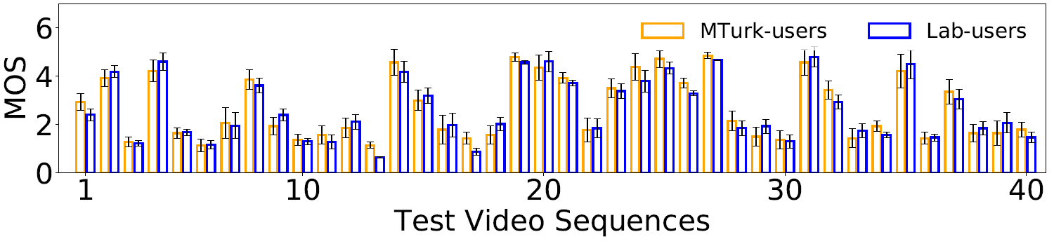
User-study
Distribution of MOS is similar across Lab and Mturk users
Notes:
Here is a subset of mean opinion scores for lab and online users. As we see, the distribution of the MOS is similar across lab and turk users. So, we use this MOS as ground-truth data and train our corresponding QoE metrics for MOS prediction.

Slide 21
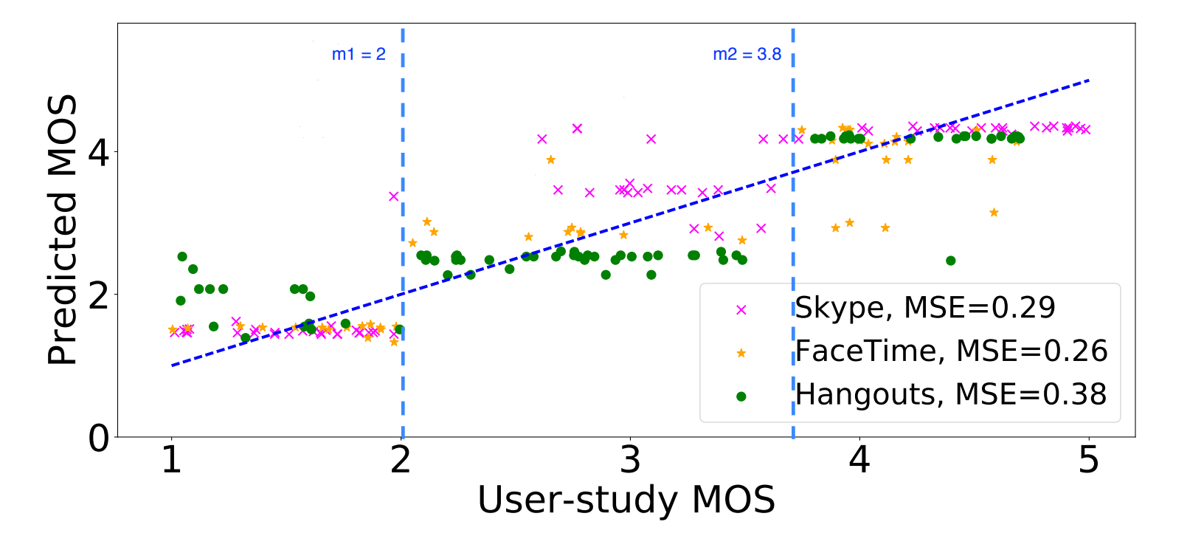
Results
A median of 90% accuracy for all three applications
Notes:
So, we wanted to classify the videos into 3 classes and hence had to find two thresholds to divide the users ratings into three classes. This threshold we select based on a greedy algorithm where we train the model with different thresholds and select the maximum accuracy giving thresholds. So with these two thresholds, we achieve a median of 90% accuracy for all three applications. And also, the mean squared error of the MOS is below 0.4 for all applications.

Slide 22
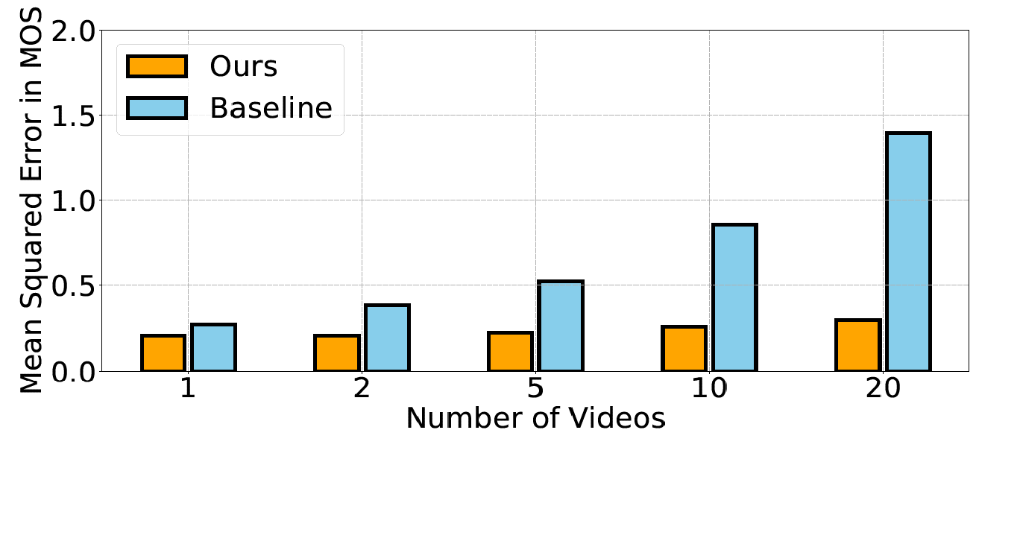
Results
Baseline has up to 1.4 MOS estimation error across 20 videos and hence failing to distinguish good /bad from average QoE
Notes:
We further compare our model with previous baseline model. The baseline model is created using the QoE metrics that I have shown in the beginning where they fail distinguish the quality of videos with diverse content. As you see, the MOS error goes till 1.4 with baseline model.

Slide 23
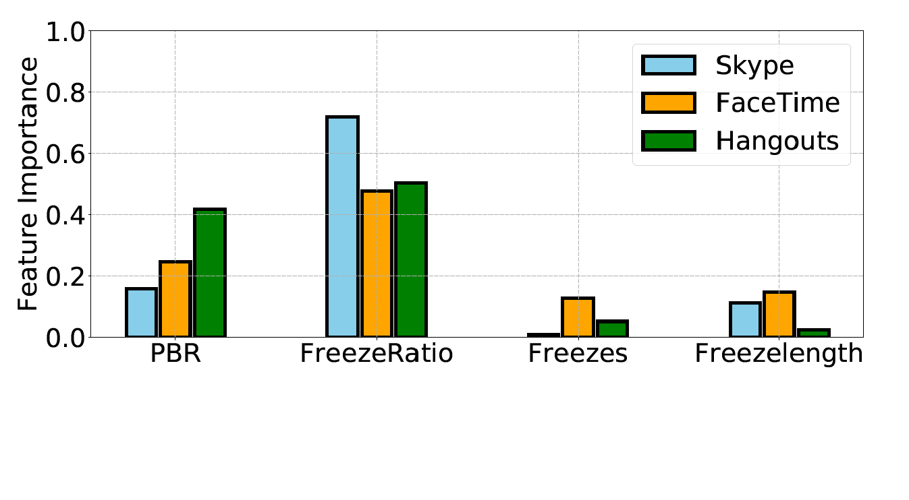
Results
Free Ratio is the most dominant feature
Notes:
Finally, we evaluate the feature importance for all three applications. We find that skype is more sensitive to freeze ratio while hangouts and facetime are almost equally sensitive to both PBR and freeze ratio. Where as the other features are not very important.

Slide 24
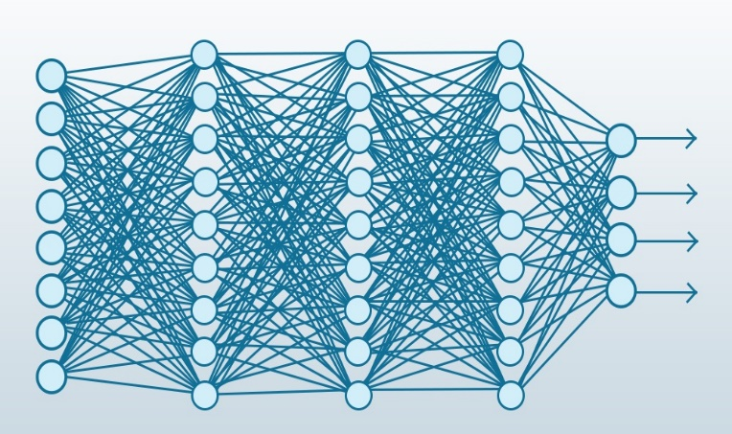
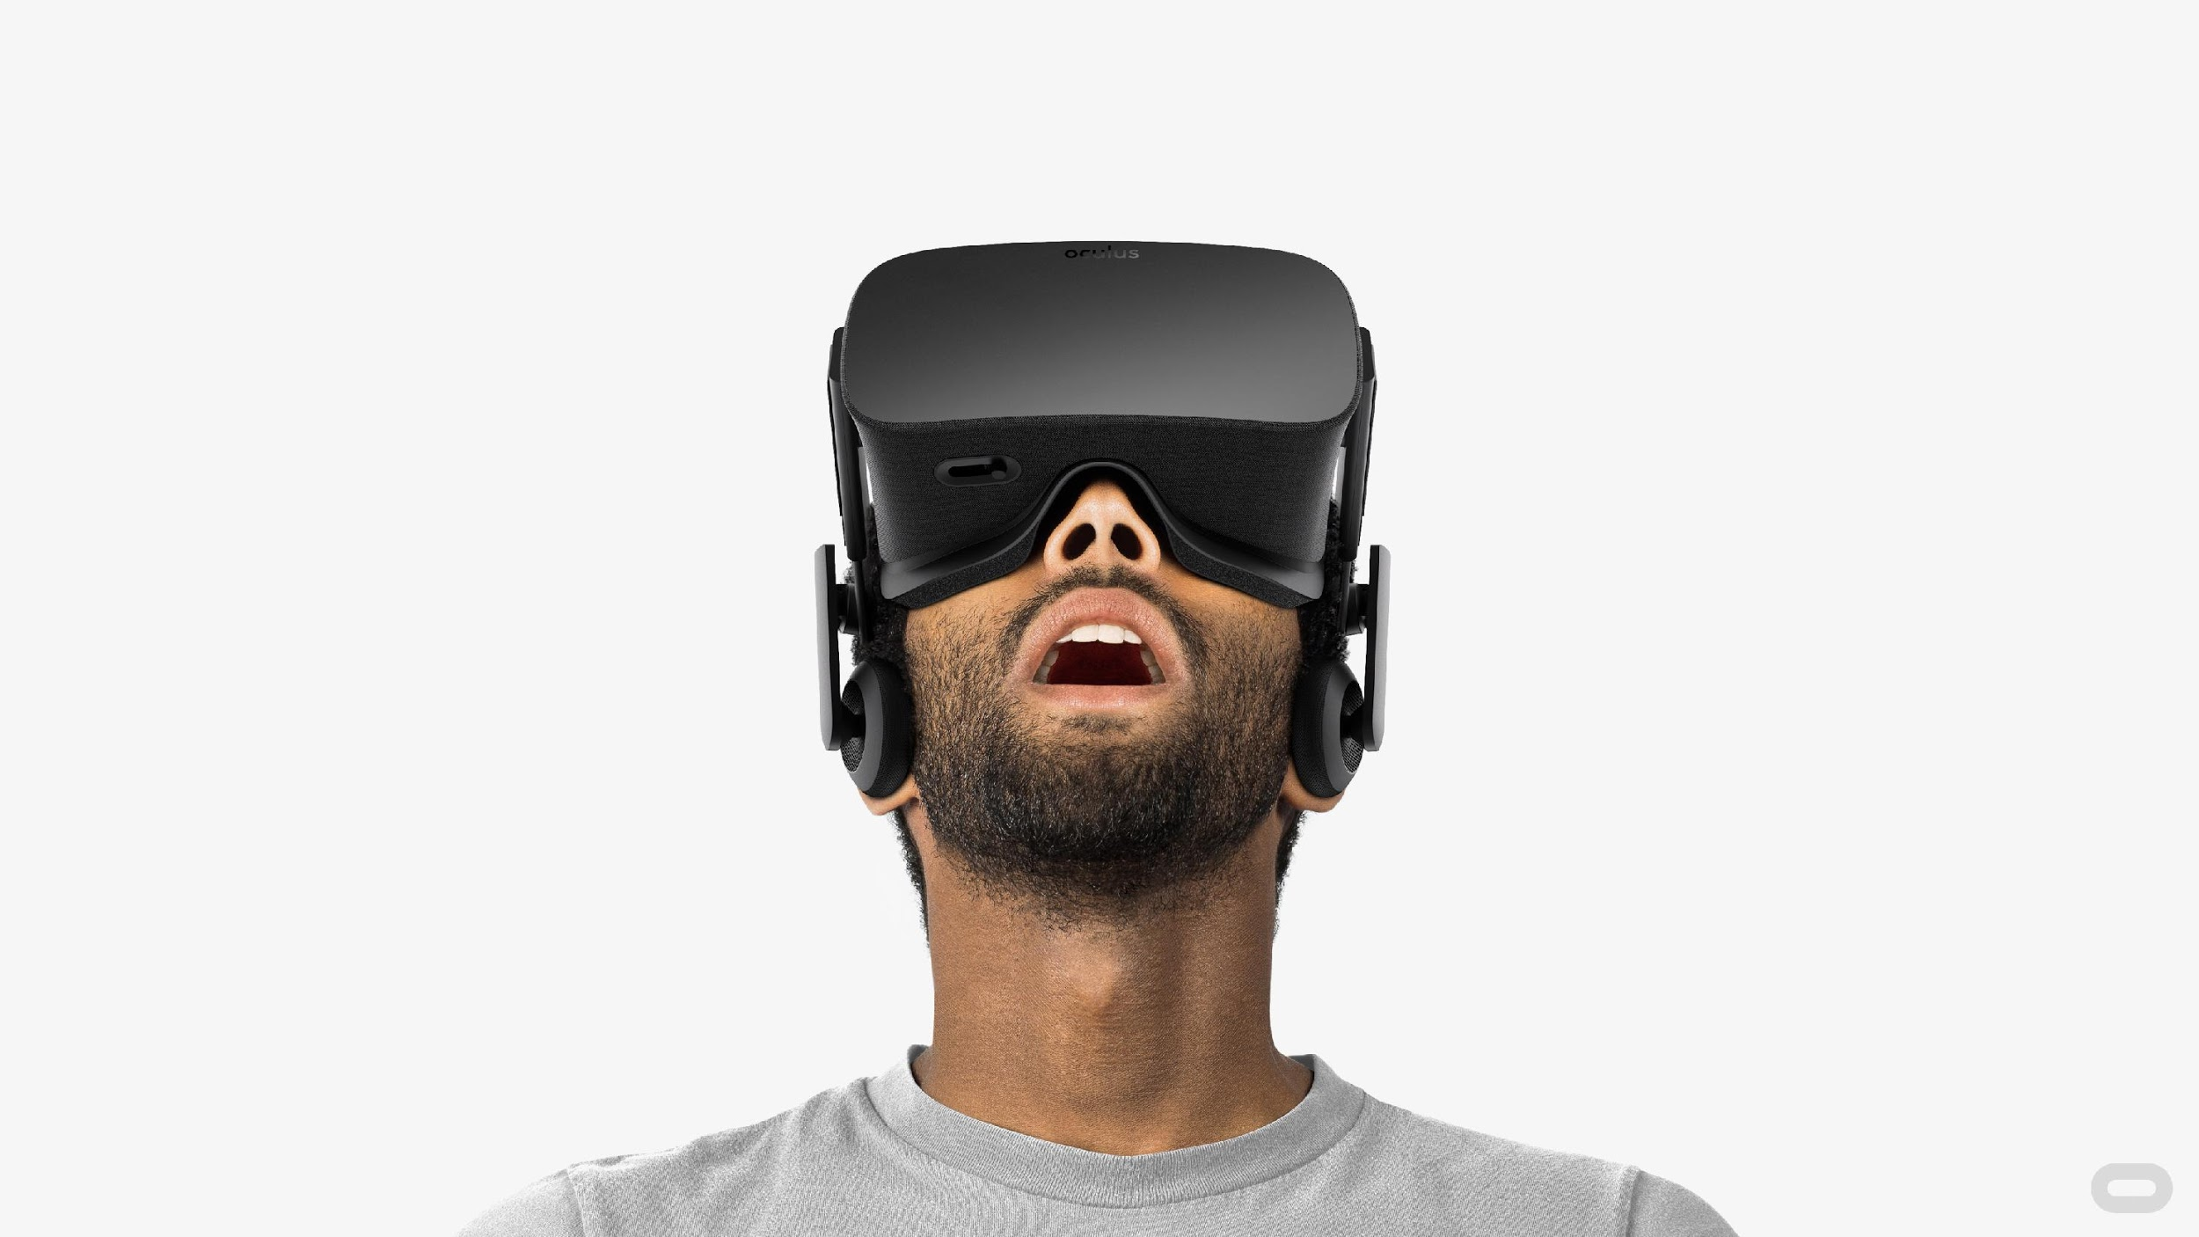
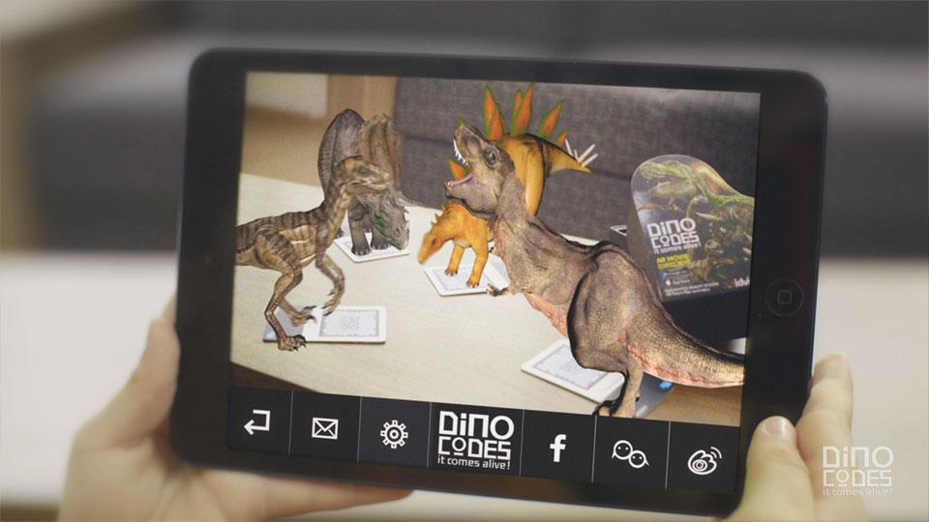

Ongoing and Future Work
Deep Learning
Deep learning + Handcrafted features
Same metrics are not suitable for other applications
Notes:
We are currently using some deep learning techniques to see if it improve the model performance. We also create a hybrid model with both deep learning features and handcrafted features that I described before. The current model does not have good performance because we do not have enough data the neural network requires to learn. So, I am currently exploring ways to augment the data to increase the training data size. And also, we find that these metrics are not useful for other application such as streaming because there we need different metrics like start-up latency and stall ratio. So, there is a scope to improve there as well. With this, the first part of my talk is over.

Slide 25
Impact of Device Performance
Notes:
Next, I will explain my study on understanding the impact of device hardware on mobile internet applications.

Slide 26
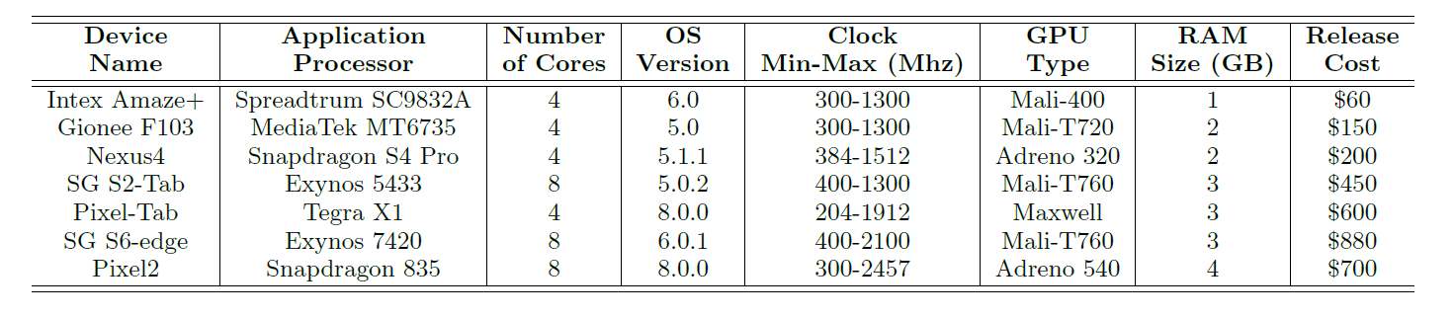
Motivation
Diversity of mobile device hardware and software
A large fraction of developing regions (about 62%-68% [1])
uses low-end smartphones
[1] Unity. http://hwstats.unity3d.com/mobile/
Notes:
The reason we investigate this is because there are diverse smartphones with diverse device hardware parameters. And, it is not clear how much of QoE is impacted by these parameters. Moreover, it is important for developing regions because a large fraction of users have low-end smartphones.

Slide 27

Designing QoE metrics
Web Browsing
Video Streaming
Video Telephony
PLT (compute, network)
Start-up Latency, Stall Ratio
Call Set-up Delay, Frame Rate
The QoE metrics are network- and device-centric
Notes:
We choose three popular Internet based applications--- web browsing, video streaming and telephony for this study. Where we use google chrome for browsing, youtube for streaming and skype for telephony. We consider different QoE metrics such as network and device-centric metrics because, we find that the applications are affected by slower network stack in OS. So, basically the network centric metrics represent the impact of slower network stack or we call second-order effect of network. (which I will show later)

Slide 28
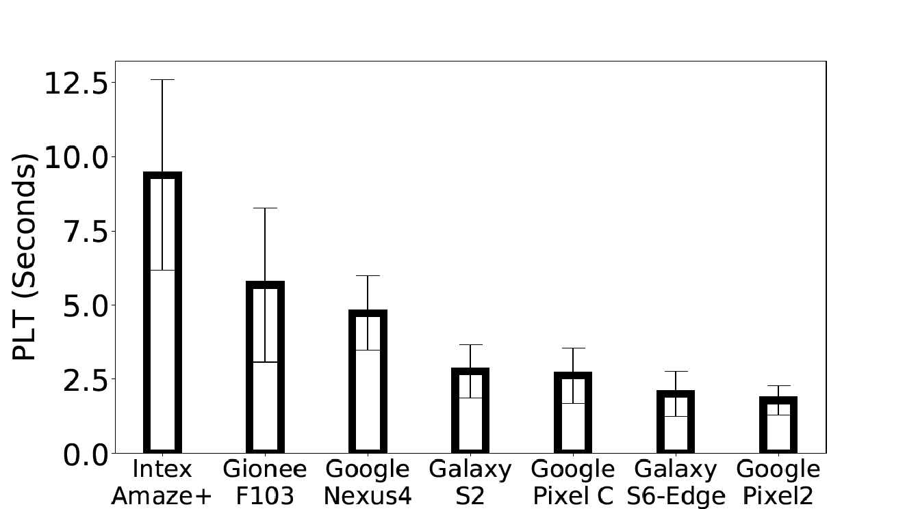
Device impact on Web browsing
An average of 7 seconds increase in PLT from
high- to low-end phones (Non-linear increase)
Notes:
As a first step we measure the QoE across seven different smartphones to see if there is any impact. For the web browsing, we observe a nonlinear increase in page load time from high to low end phones. As you see, there is an average of 7 seconds increase here.

Slide 29
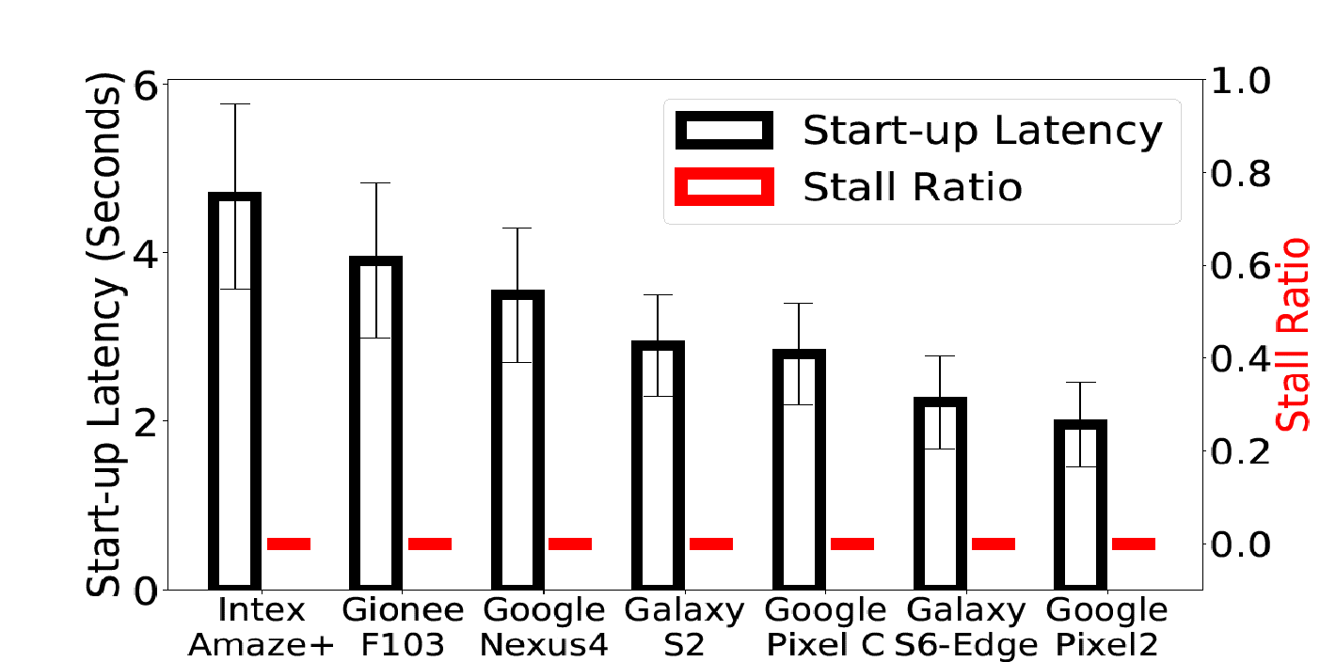
Device impact on video streaming
An average of 3 seconds increase in start-up latency from
high- to low-end phones (Linear increase)
Stall ratio is zero across all phones
Notes:
For streaming, there is a linear effect on start-up latency while there is zero impact on stall ratio.

Slide 30
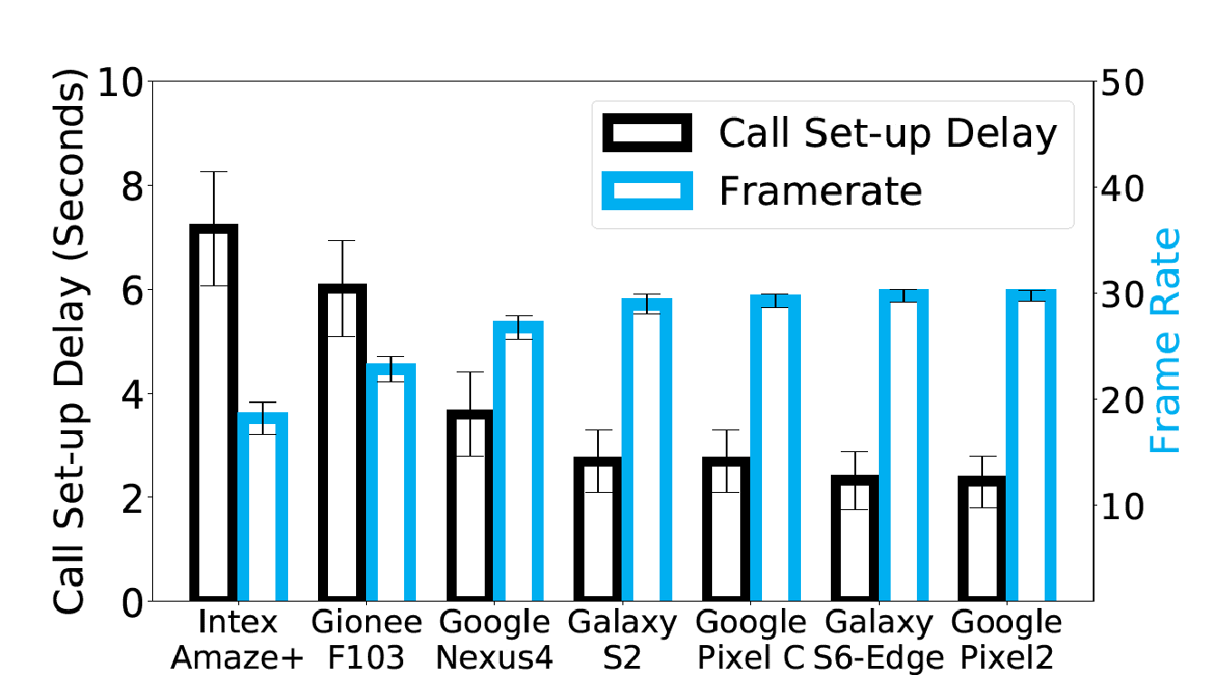
Device impact on video streaming
An average of 5 seconds increase in call set-up delay from
High- to low-end phones (Linear increase)
An average of 12 frames per second decrease from
high- to low-end phones (Linear decrease)
Notes:
And different from the above applications, telephony has linear effect on both call set-up delay and frame rate. We dig deep into individual device parameters to see why this performance gap across devices and why the applications have different impact with same device hardware.

Slide 31
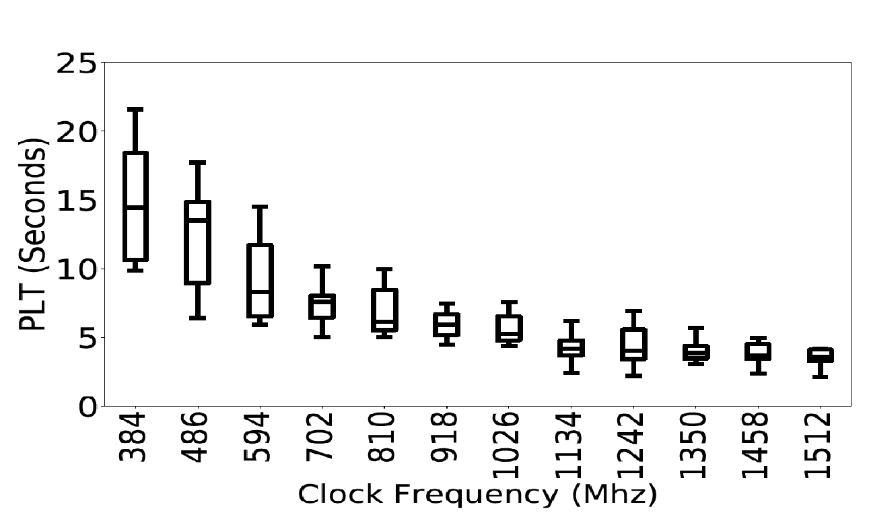
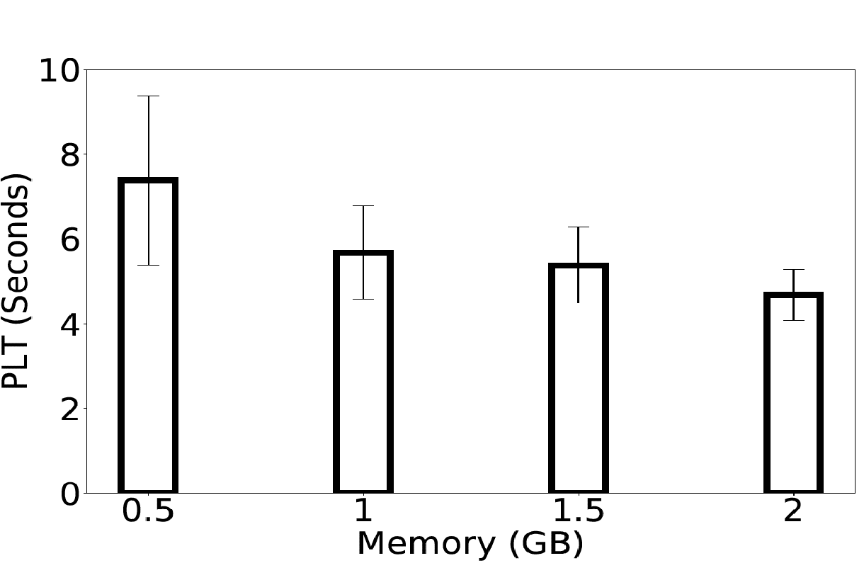
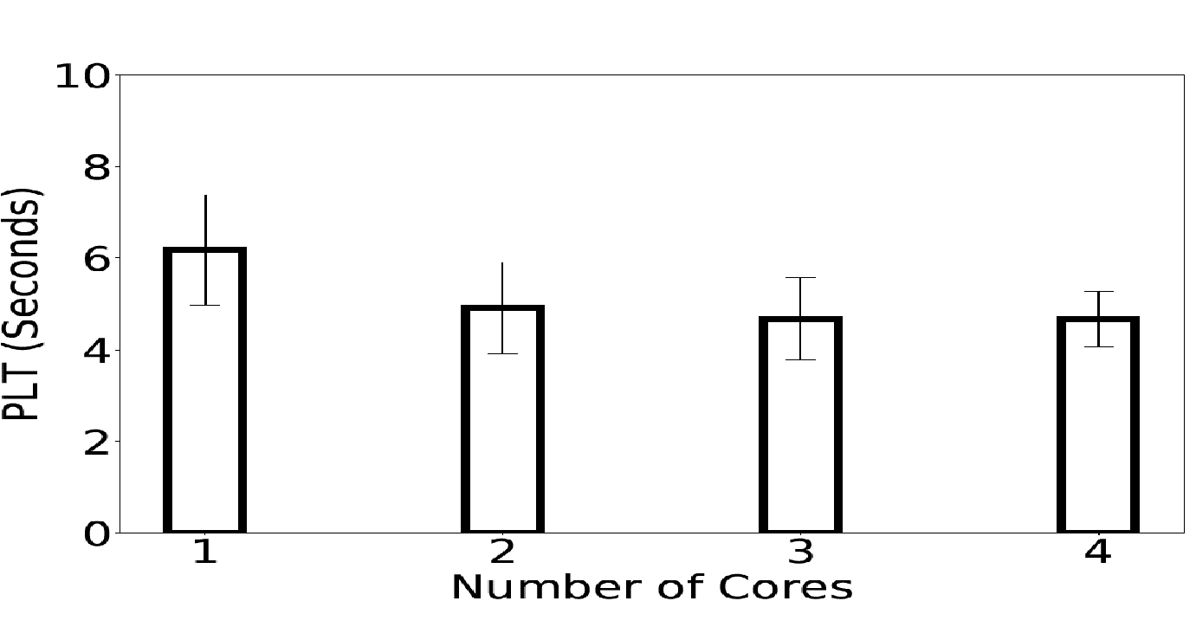
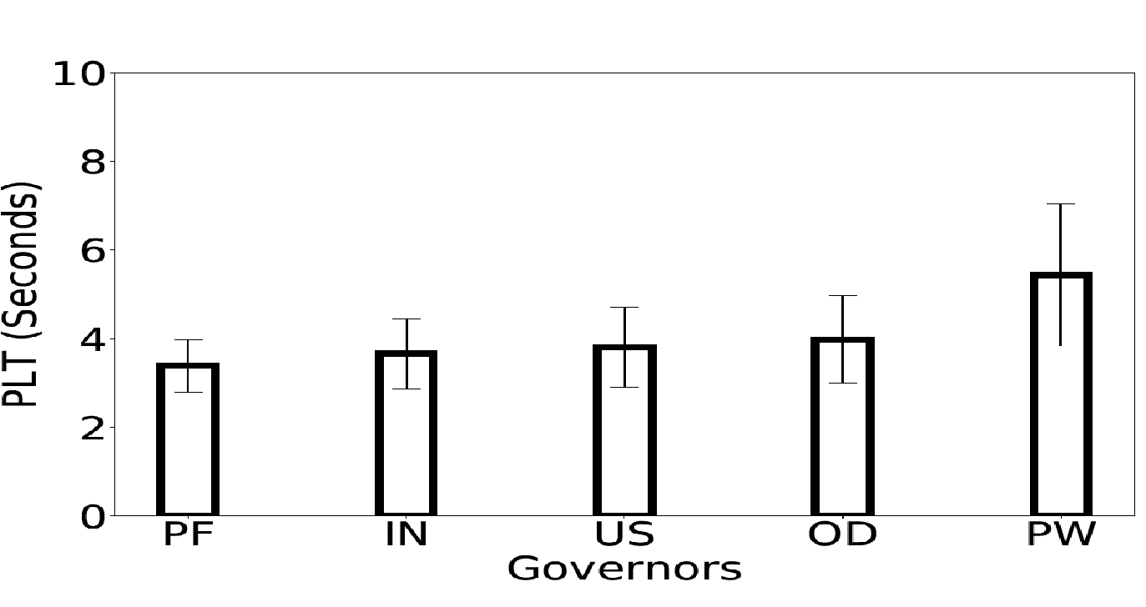
Impact of device parameters Web browsing
Web browsing is underutilizing multi-cores and significantly affected under slower clock frequencies
Notes:
So, we select four representative device parameters that impact the application to a greater extent – clock frequency, memory, number of cores and governors. Interestingly, among the four parameters only clock frequency has most impact on web browsing. We observe an average of 10 seconds increase in PLT from high to low clock. So, we can say that CPU clock is the most critical parameter for browsing experience.

Slide 32
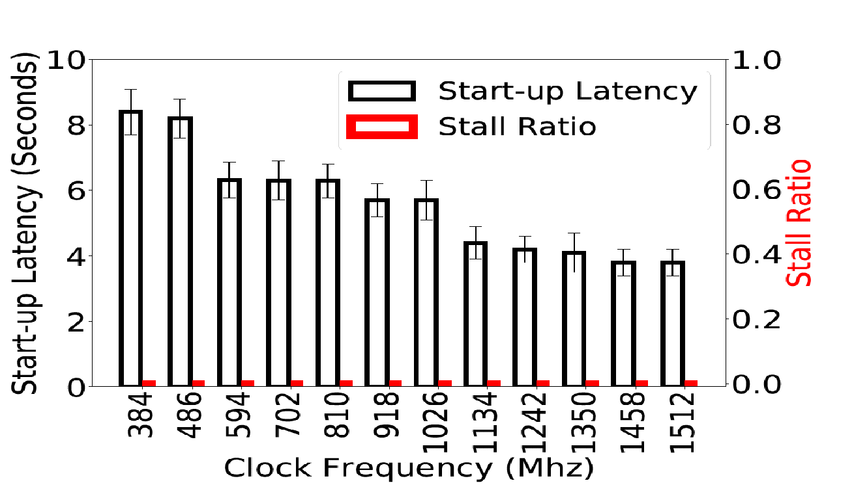
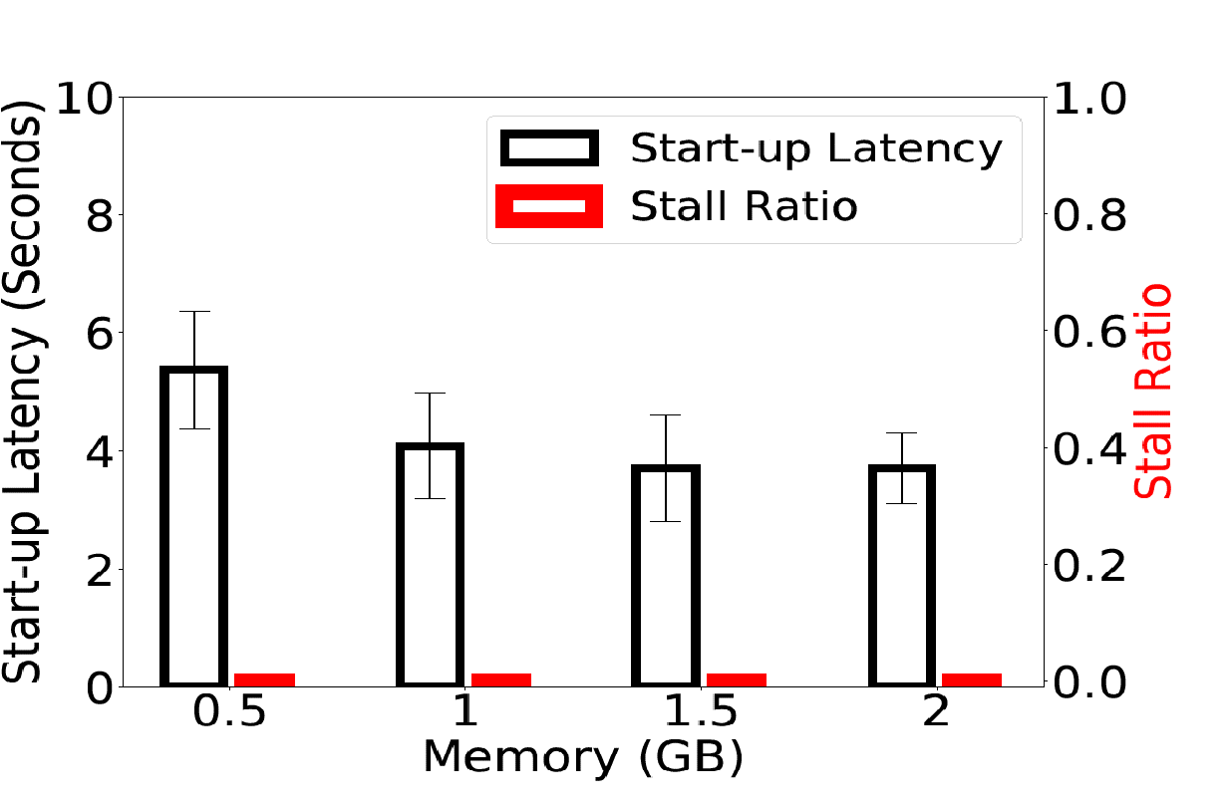
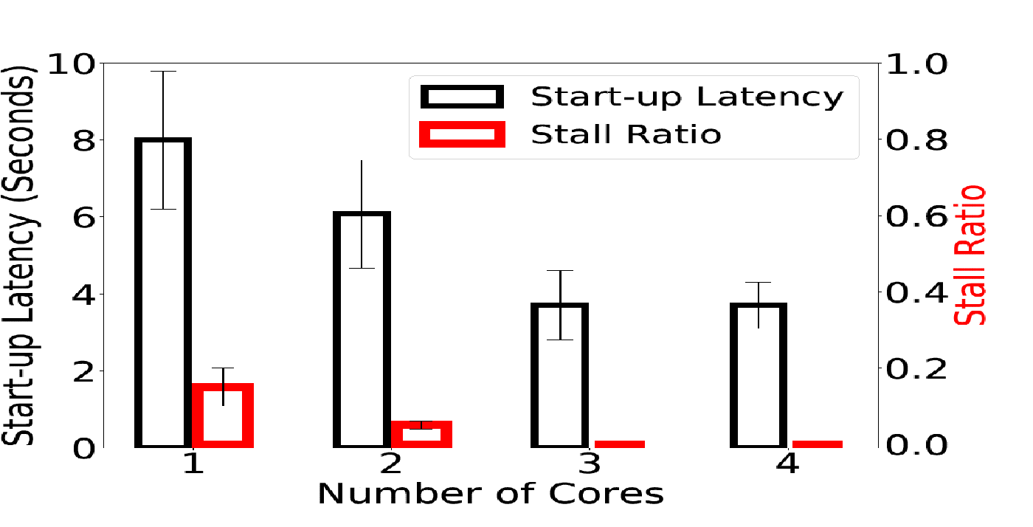
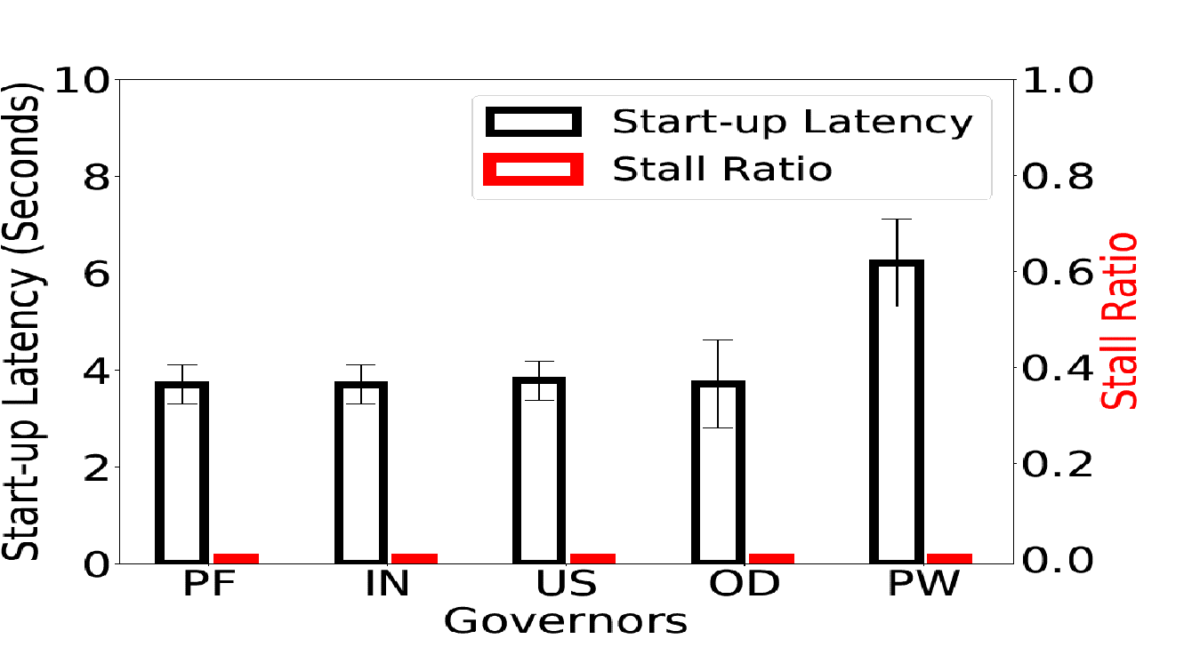
Impact of device parameters video streaming
Effective utilization of hardware accelerators, multi-cores, and
Prefetch opportunity
Notes:
Whereas, video streaming is greatly impacted by number of cores as opposed to clock frequency. This is because several video specific optimizations such as efficient use of hardware accelerators for video decoding, using multi-cores for post processing of muxing and demuxing of audio and video, and prefetch opportunity of streaming. Recall, web browsing is significantly impacted by clock because it was neither using coprocessors nor multicores.

Slide 33
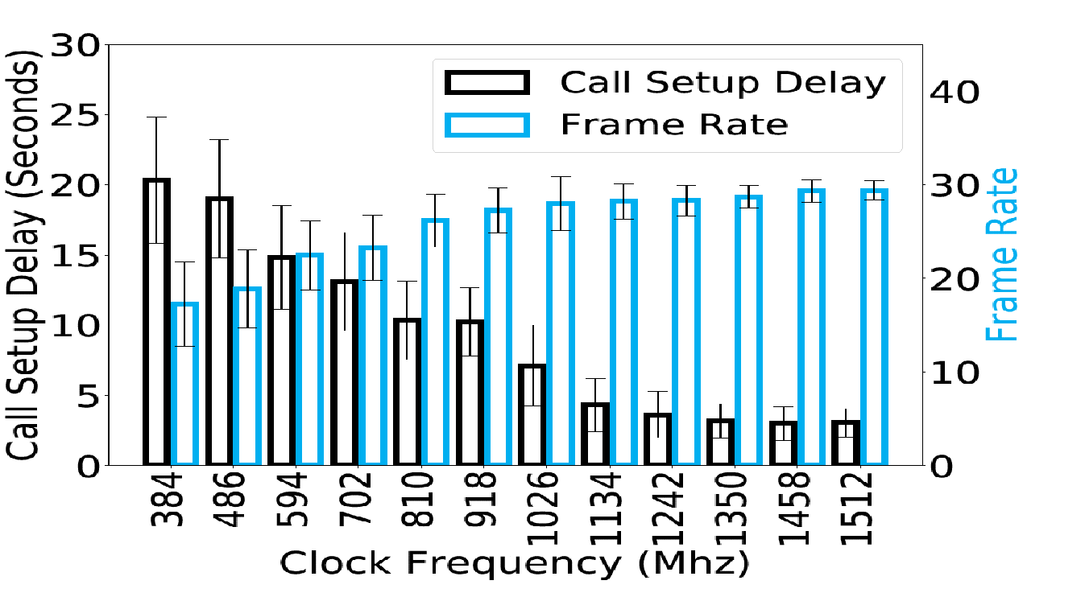
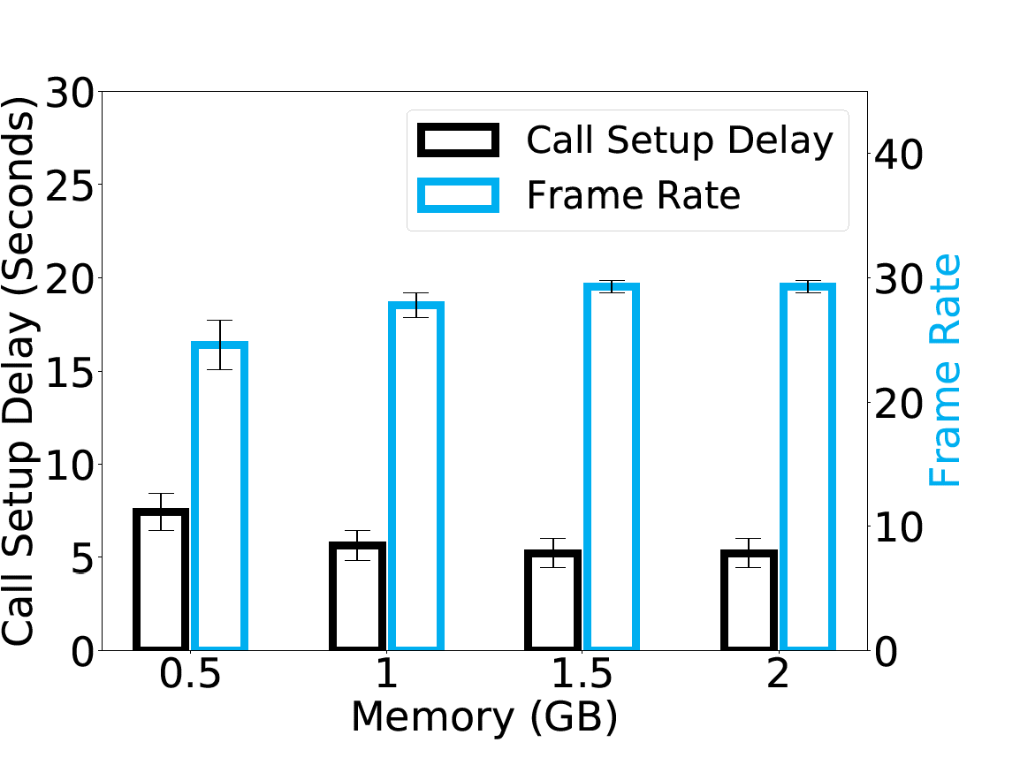
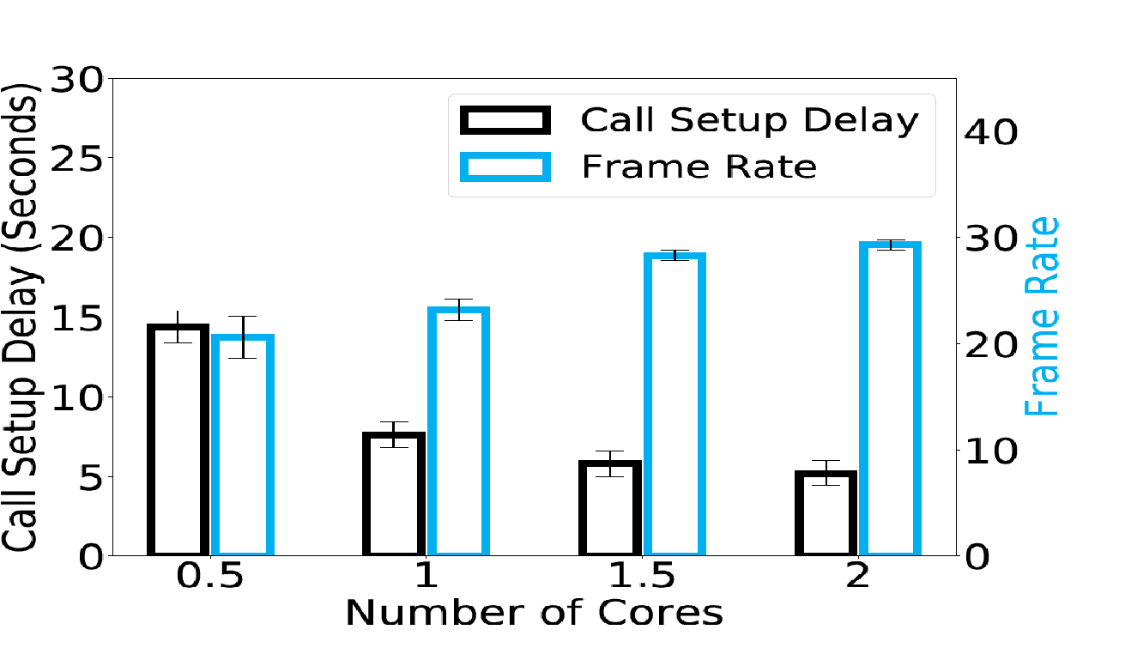
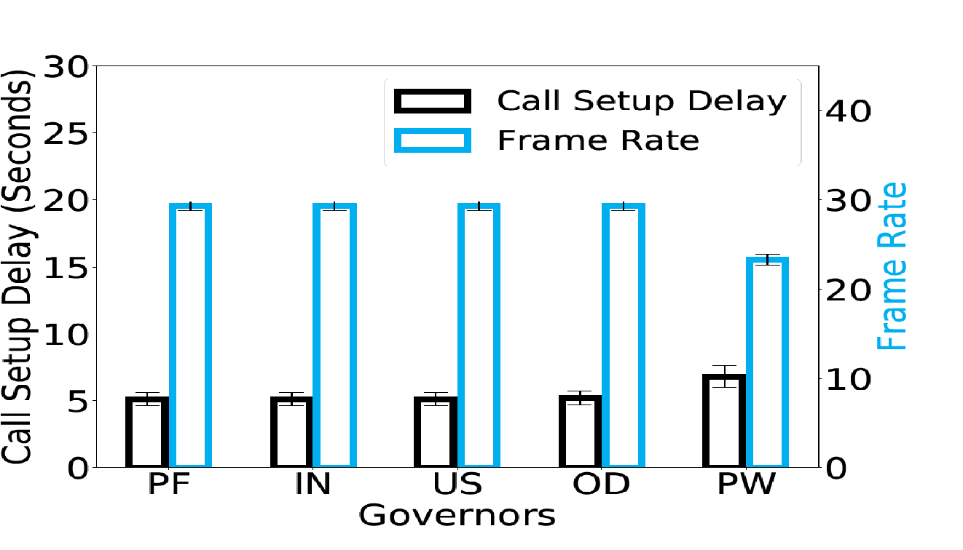
Impact of device parameters video telephony
Frame rate is affected under slower clock frequencies:
second-order effect on network
Notes:
However, telephony has different trend compared to browsing and streaming. It is effected by both clock frequency and number of cores but linearly. Under slower clock frequencies, network throughput is reduced because of network processing overhead. This is slowing down the call setup delay and slower framerate even though video coding offloaded. And, it is also affected by number of cores because the post processing is relying on number of cores. On the other hand, all three applications have same trend with memory and governors.

Slide 34
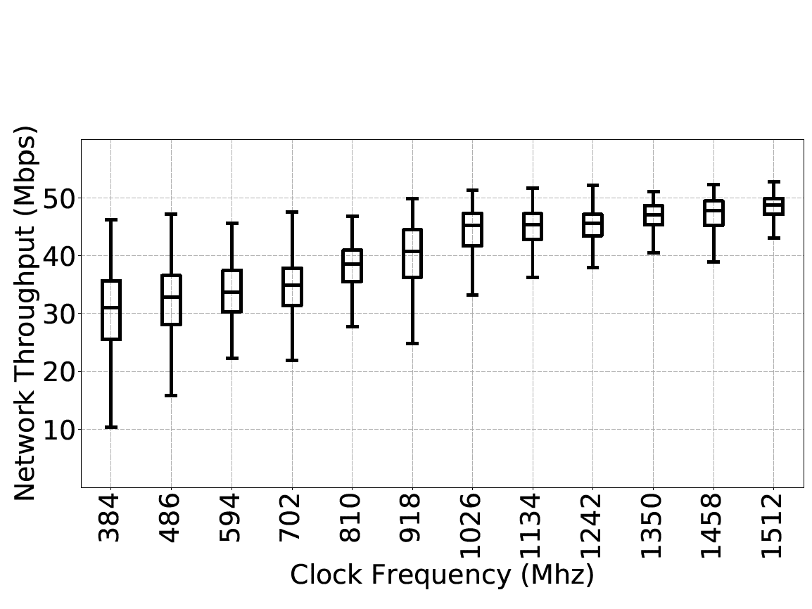
Second-order effect of Network
QoE is affected both by slowing down the compute
and the network components of the application
Notes:
This is what the second-order effect of network that I was talking about. See a decrease of 20mbps throughput from high to low clock. This shows that QoE is affected both by slowing down the compute and network components of the application.

Slide 35
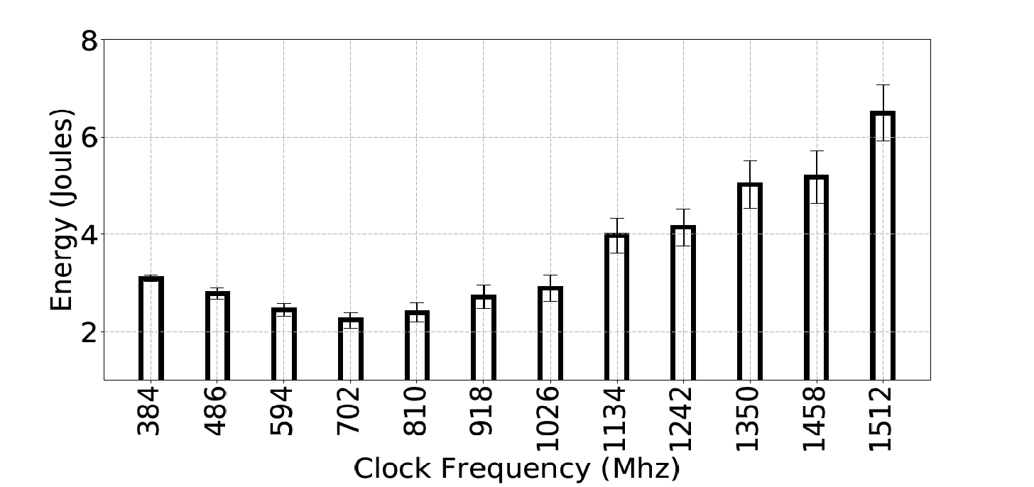
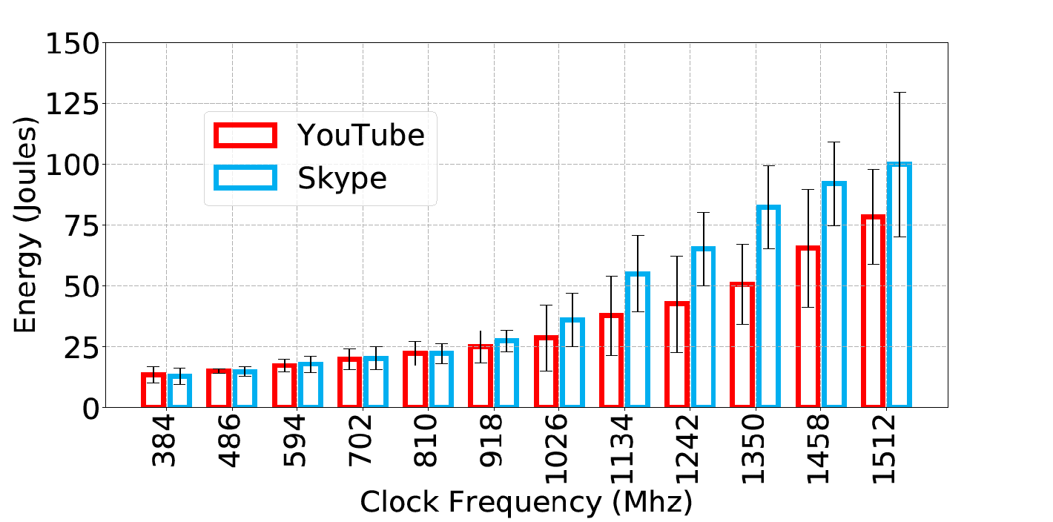
Impact on Energy
How about a QoE-driven frequency governor?
Notes:
Similarly, the energy consumption is very different for web browsing from video applications. For example, under 384 Mhz clock, browsing consume more energy than 1026 clock. This is because the time to load has an exponential increase which is multiplied by power. And, streaming and telephony have expected trend that telephony consumes more because it is interactive and streaming is passive. But, one thing to notice is that after a certain point, there is not much of an improvement in QoE, but the power is increased exponentially. But, we found that the default clock frequency scaling algorithm increases the clock aggressively for the performance which is not a good choice. Hence, we suggest a QoE driven governor that benefits both power and performance.

Slide 36
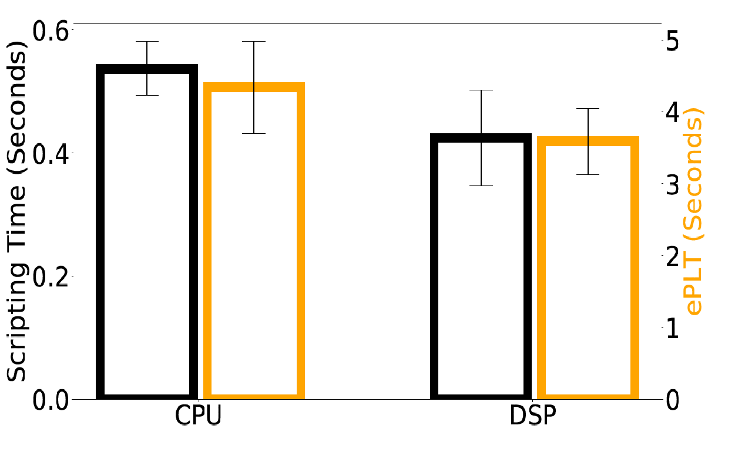
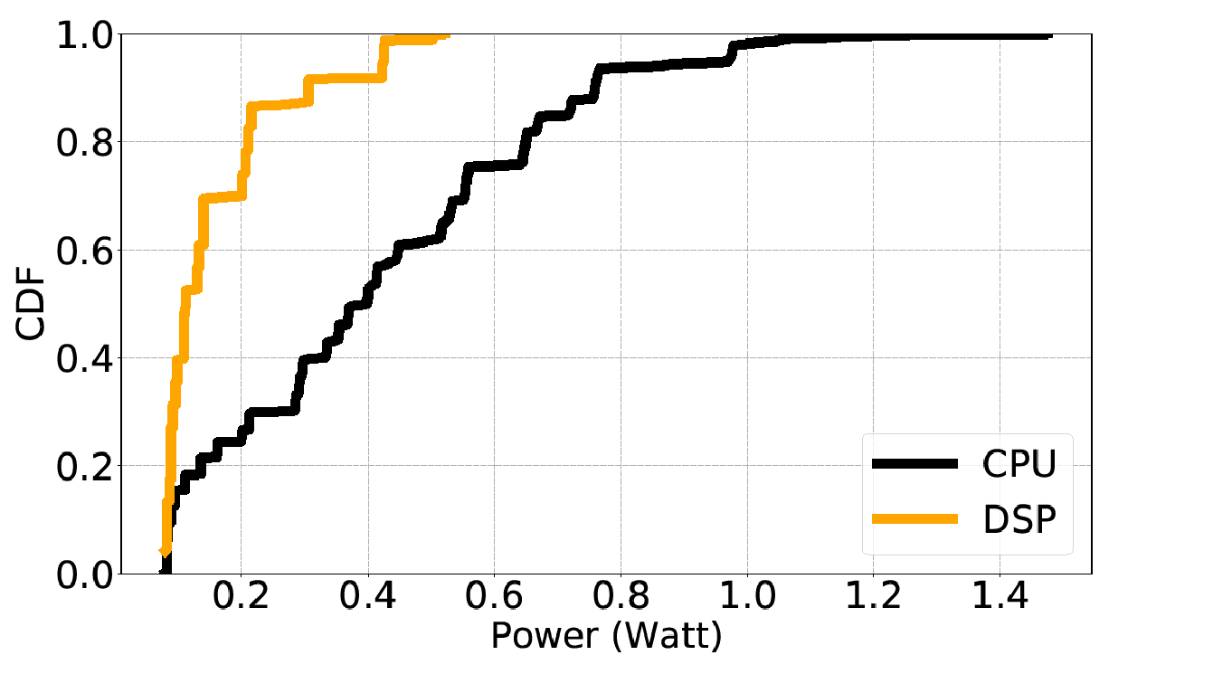
Can we offload Web computation?
Modest improvement in PLT
But a 4x reduction in energy
Notes:
As we have seen that web browsing is the most affected application especially under slower clocks, we chose improve browsing by offloading certain part of computation similar to video applications. While find modest improvement in PLT, the energy benefits are significant.

Slide 37

Better performance under slower clock frequencies
An average of 18% improvement in PLT
Notes:
We further evaluate this under slower clock frequencies and find that a 18% improvement in PLT. Although, we did not explore this offloading opportunity fully, we do find that this a promising alternative to improve web browsing. With this, my second part of the talk is complete.

Slide 38
Conclusion
QoE
QoE
Network
Bottlenecks
Device
Bottlenecks
ACM/IEEE IWQoS’18
In Submission (IMC’18)
Thank You
Notes:
To conclude, I have been studying the QoE of different mobile internet applications across diverse network and device conditions. We find that the architecture of these applications are very different from one another and are impacted by network and device very differently. We made an initial effort to improve the QoE of these applications both from network and device perspective. Please let me know if you any questions or comments. Thank you.

